Slide 1
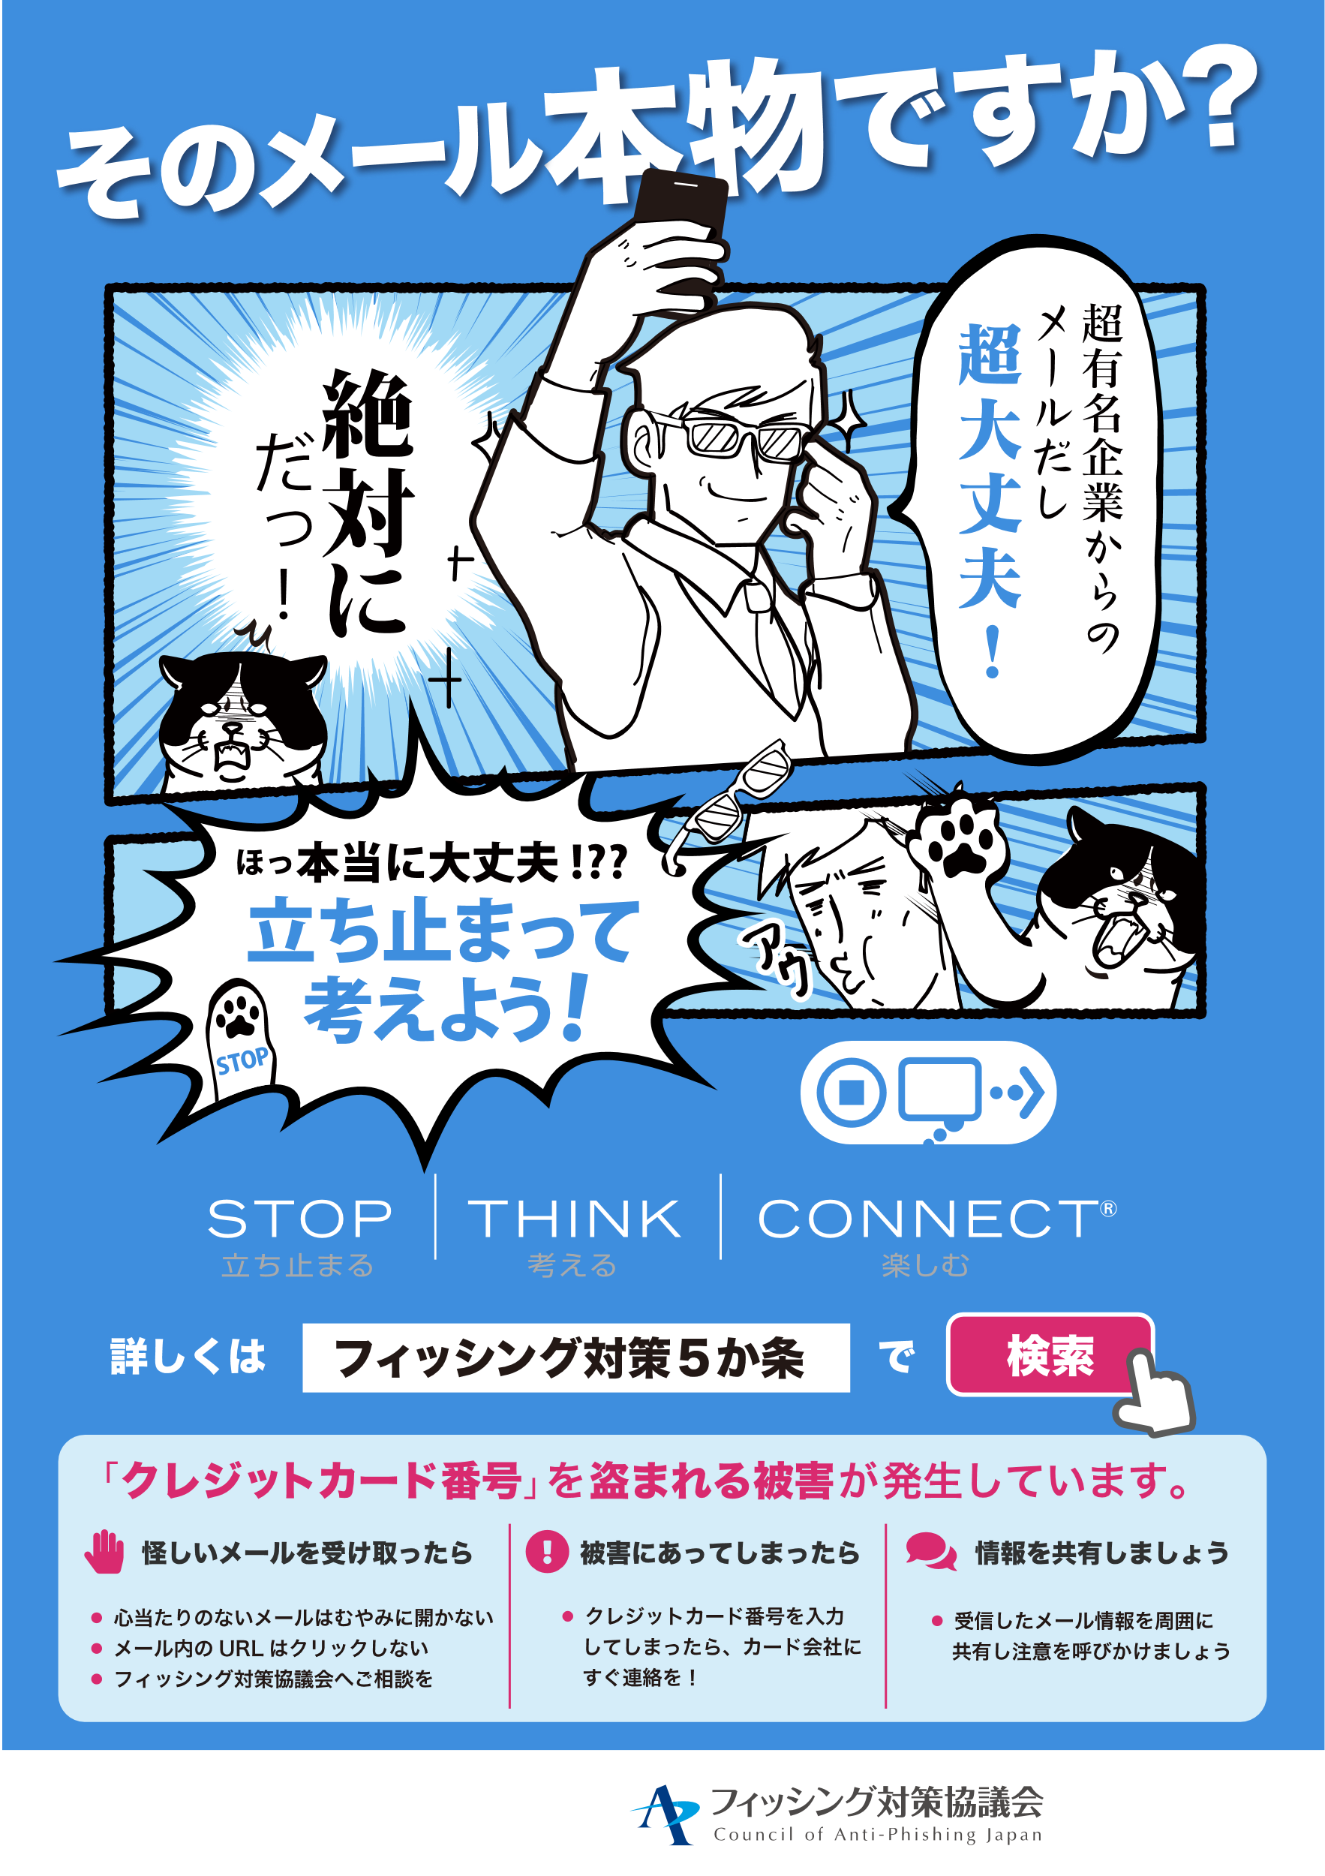

Designed by Eri Hiroishi, BBSS Corporation. Copyright © Council of Anti-Phishing Japan ALL RIGHTS RESERVED.

